Slide 1
changes in the understanding
of
SCIENCE
By Ron Suter, Melbourne
Credit: ABeka Science Text Books for frames 3-7, 19.

Slide 2
16th Century
The earliest European scientists were all believers in God the Creator Who brought all things into existence, and Whose care governs the functioning of His world.
Could His laws be discovered?

Slide 4
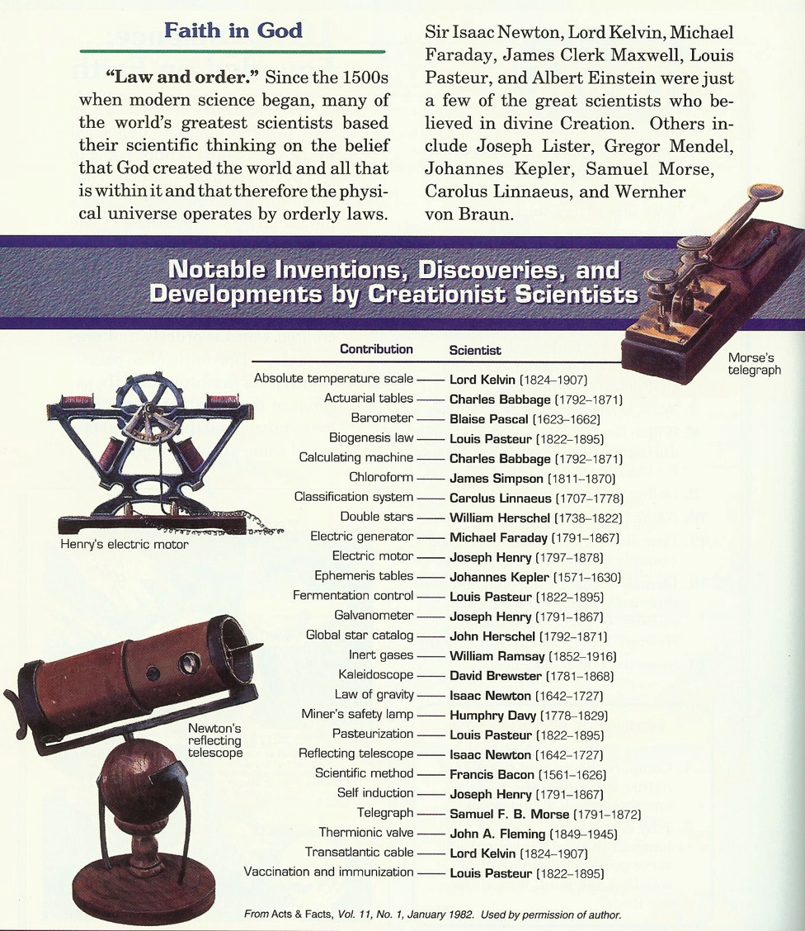
Unless material
things behave in
a consistent,
orderly manner,
we cannot use
science
to discover any
“laws of nature”.

Slide 5
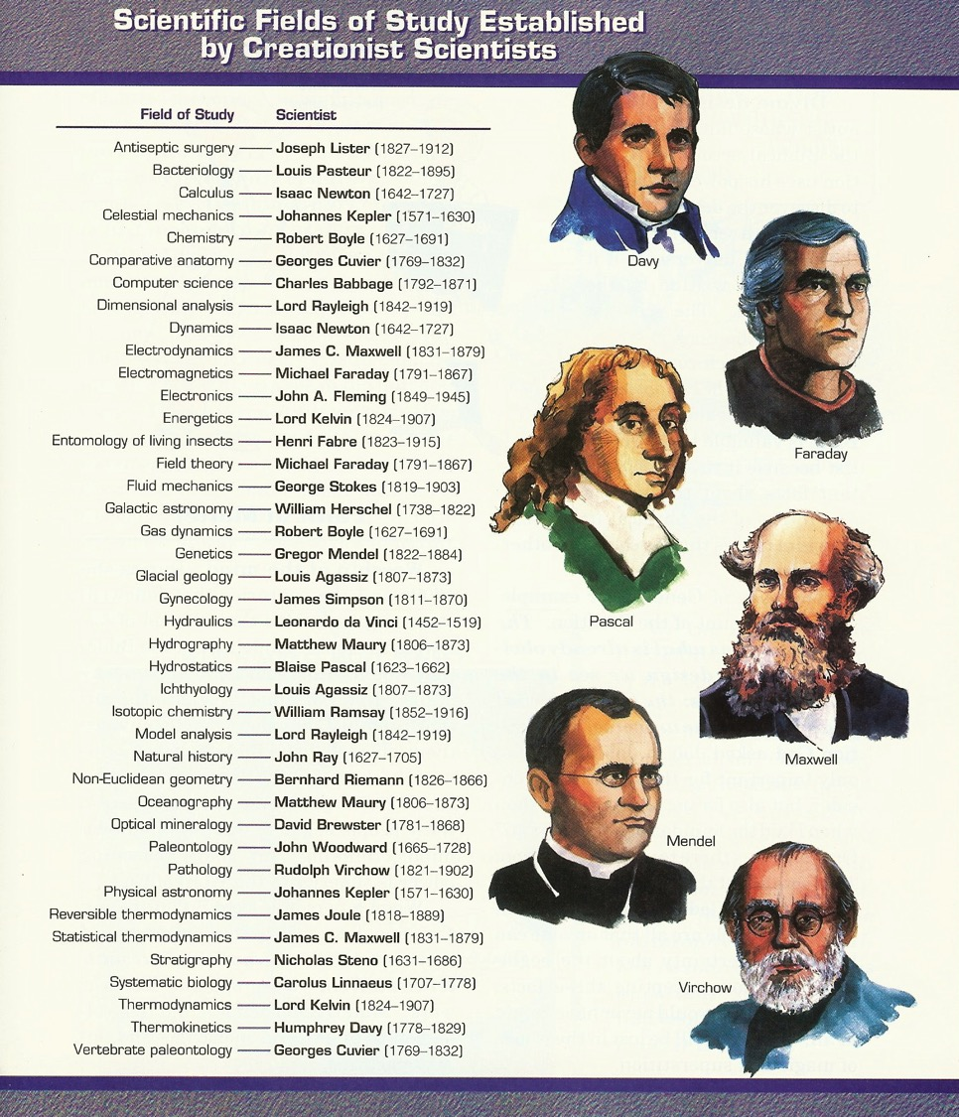
All of the
scientists in this
list believed in a
God who created
an ordered
universe.

Slide 6
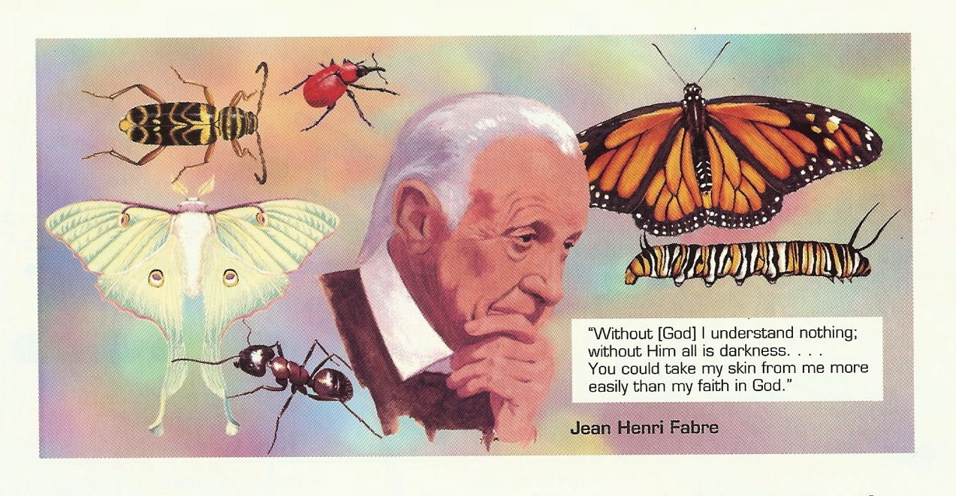
1823-1915

Slide 7
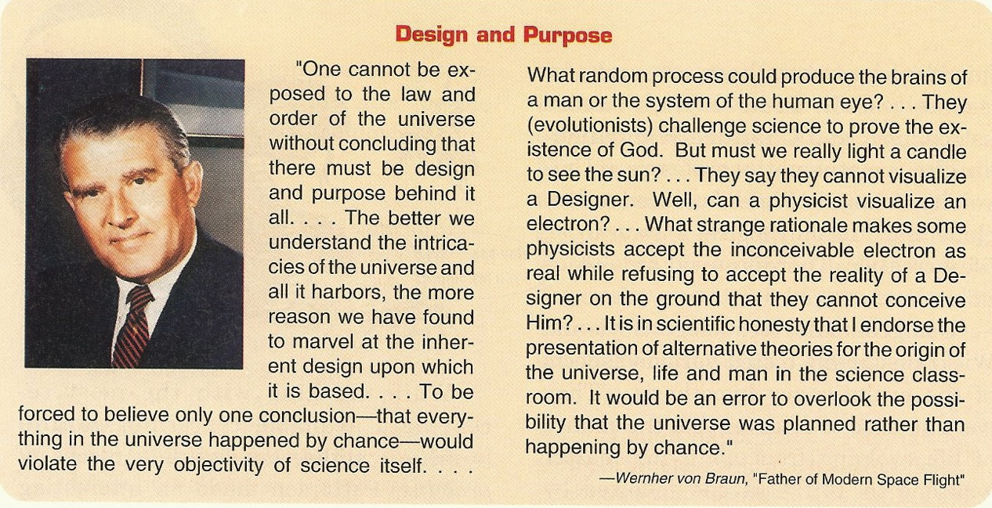
1912-1977

Slide 8
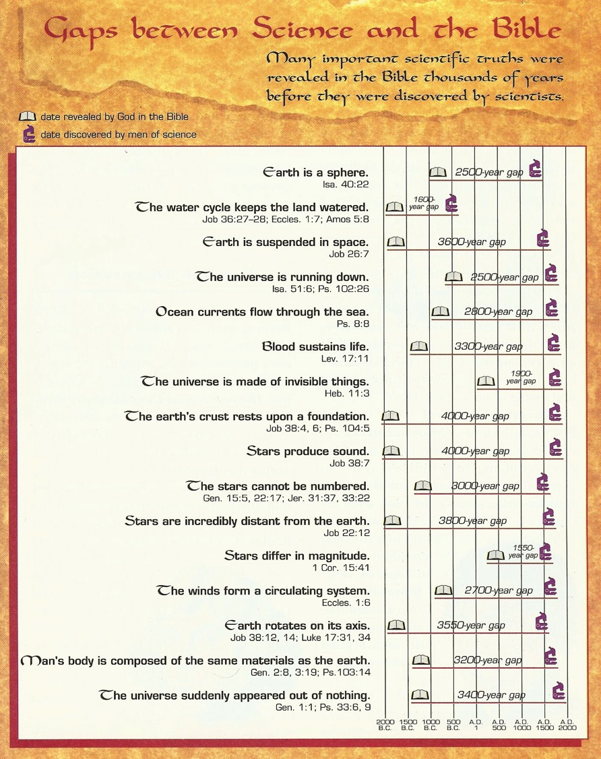
Time
The
Bible
had it
first.
Time Scale

Slide 9
Technological Progress
Much progress took place in science and technology (applied science) resulting from the studies and initiatives of these God-fearing, careful scientists.

Slide 10
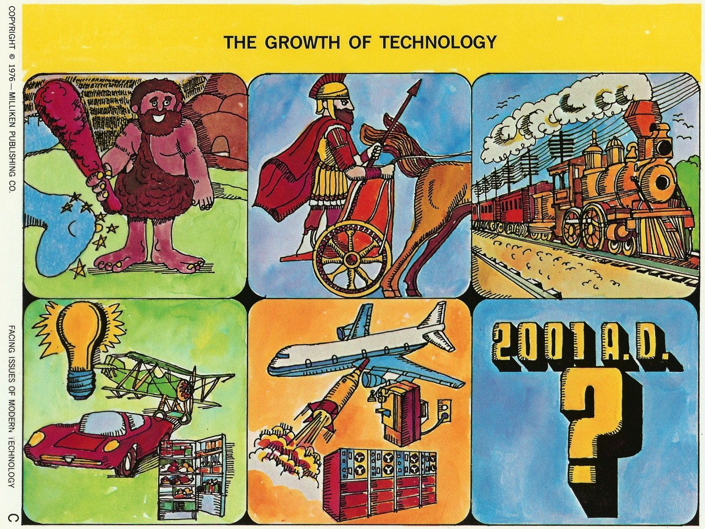
Ever onward
and upward?
2013

Slide 11
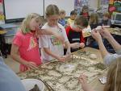
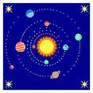
Experiments
Observations
Involvements in Science
Science and Technology
Questions
Applications
Tool? or Scientism?

Slide 12
Significant Changes (19th Century)‏
began with those scientists who were specifically studying rocks and fossils (James Hutton, Charles Lyell) and the philosophers (prominently Herbert Spencer) who were supporting them.
These writers were intent on finding

Slide 13
answers to their questions about fossils and the age of earth’s rocks that had no reference to the Bible.
They did not accept that the Bible had any relevance to their lives or to their academic pursuits.

Slide 14
Book:
“Why Scientists Accept Evolution”
by Clark, Robert T & Bayles, James D in 1966, (Baker, Grand Rapids, MI.), records the opposition of Lyell, Darwin, Spencer & others to the Bible in general and to “Moses” (Genesis Flood) in particular.

Slide 15
Anti-God Writers Proposed,
that only naturalistic processes should be studied for determining the rates at which things happen; and then assumed that such rates have been constant throughout geological time.
(Cf. Ps. 14:1, 53:1)‏
(Cf. 2 Pet.3:3,4)‏

Slide 16
They then declared that:
1. Supernatural topics should not be introduced into scientific theories.
2. Scientific studies should only investigate natural objects & events.
3. Such empirical science is superior to any other ways of learning & knowing. (“Only materials exist.”)

Slide 17
Thus Science came to be understood as an activity using only peoples’ own skills and cleverness, without having any reference to, or assistance from, God the Creator Who, for them, didn't exist. (Materialism)‏
And the evolutionary hypothesis came to be accepted (wrongly) as established fact.

Slide 18
Assumptions behind schemes of evolution:
Non-living materials gave rise to living things.
Spontaneous generation happened only once.
Viruses, bacteria, plants & animals are all related
Protozoa gave rise to metazoa.
The various invertebrate phyla are interrelated.
The invertebrates gave rise to the vertebrates.
Fish...amphibia, ...reptiles, ...birds & mammals.
(After G.A.Kerkut,
1960)‏

Slide 19
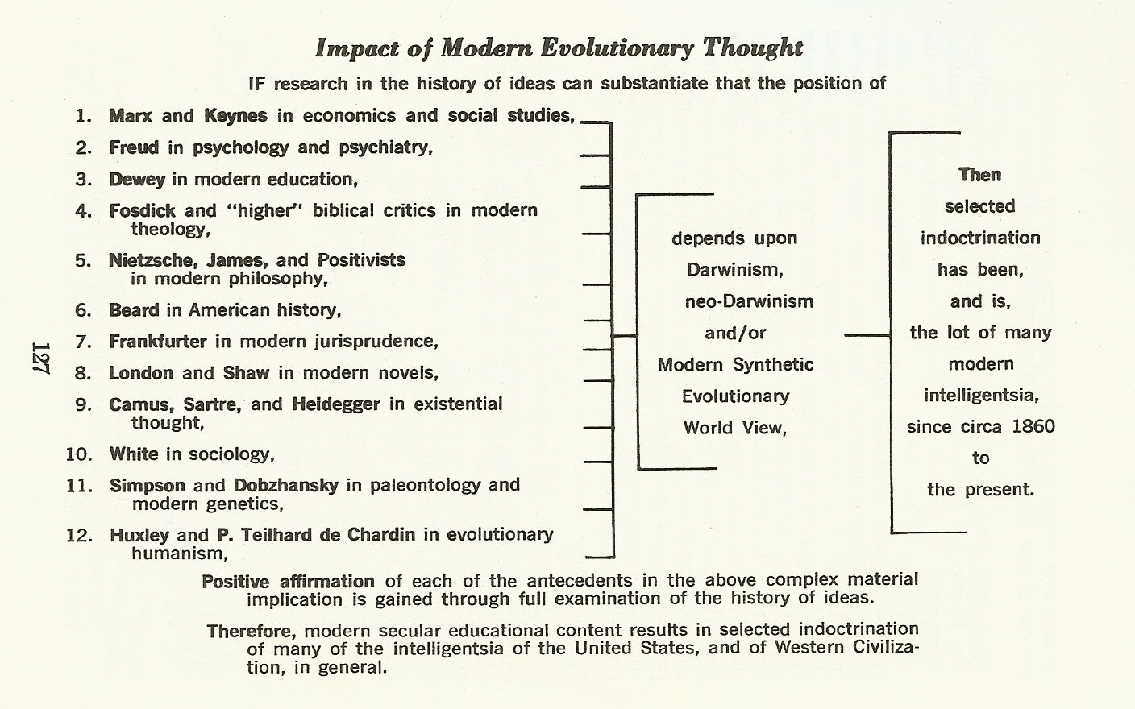
John N. Moore
“How To
Teach Origins”

Slide 20
In 1947 C.S. Lewis wrote…
“Men became scientists because they expected Law in Nature, and they expected Law in Nature because they believed in a Legislator.
“In most modern scientists this belief has died.”

Slide 21
There Were Witnesses:
George Macready Price, during the 1920’s – 1940’s, was writing strongly in favour of creation by a Designer & Biblical catastrophism.
Henry Morris & John Whitcomb, in 1961, wrote The Genesis Flood, sparking a revival of Biblical creationism which continues today.

Slide 22
Zola Levitt, a Christian journalist, interviewed Dr. John N. Moore and then published “Creation – A Scientist’s Choice” in 1976.
Michael Denton, an evolution-believing microbiologist wrote “Evolution – A Theory in Crisis” in 1986.

Slide 23
Thus, at the Dawn of 21st Century,
There are many secular scientists who want to pursue their science in a totally secular way…. and
There are growing numbers of informed Christians who realize the lack of evidence for evolution and the strength of evidences that support the biblical outline of history.

Slide 24
Secular (1)‏
Richard Lewontin, geneticist, 1997. “It is not that the methods & institutions of science somehow compel us to accept a material explanation of the phenomenal world,... we are forced by our a priori adherence to material causes to create an apparatus of investigation and a set of concepts that produce material explanations, no matter how counter-intuitive, no matter how mystifying to the uninitiated. Moreover, that materialism is an absolute, for we cannot allow a Divine Foot in the door.”

Slide 25
Secular (2)‏
Scott Todd, immunologist, 1999. “Even if all data point to an intelligent designer, such an hypothesis is excluded from science because it is not naturalistic.”

Slide 26
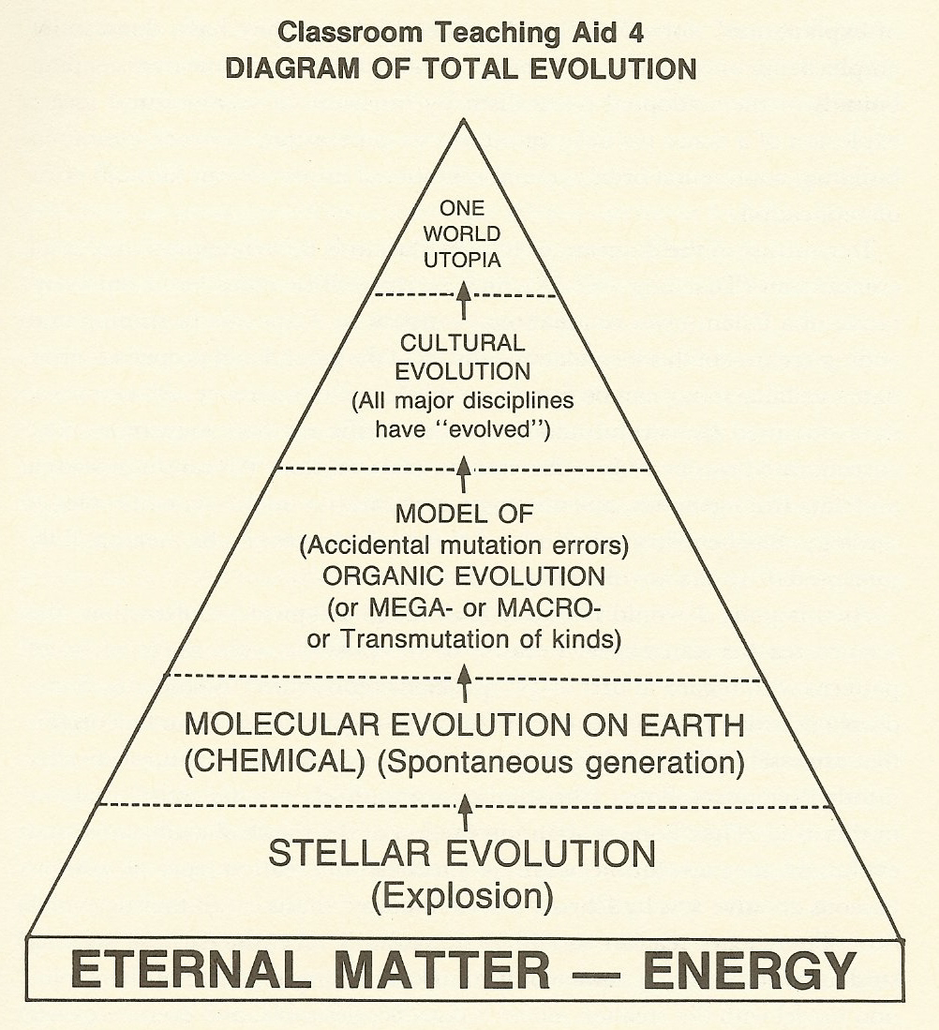

Slide 27
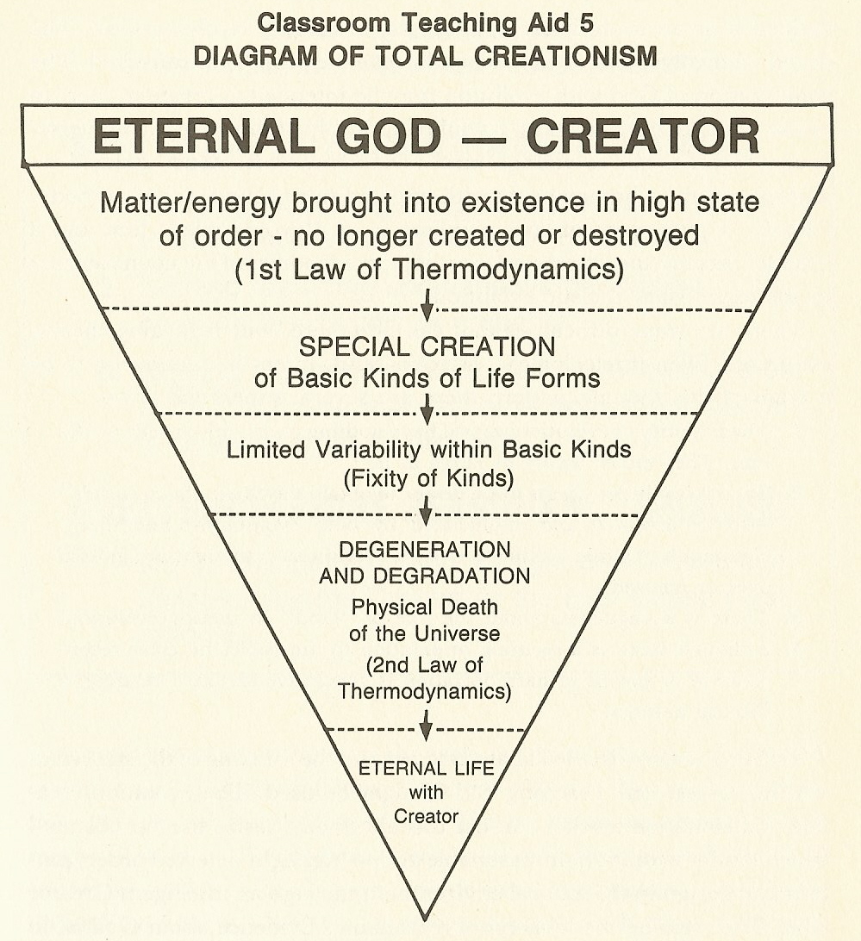

Slide 28
A Biblically Informed Definition of Science
Careful, thoughtful observation by people began when Adam named the animals and birds (Genesis 2:19,20). Then Adam and Eve began to enjoy fellowship with God in His special garden, part of His perfectly created earth (Genesis 1:31). After Adam and Eve sinned by rebellion, the whole earth was cursed (Genesis 3) and remains under the curse until its ultimate redemption and re-creation (Romans 8:18-23; Revelation 21:1).

Slide 29
About 1700 years after creation, another series of events affected the whole earth’s crust and living creatures during the Great Flood of Noah’s time (Genesis 6:5-9:17).
Later, at the Tower of Babel (Genesis 11:1-9) there began major languages and cultures as groups of the human race started their migrations to many parts of the globe.
The earth that is now available for observation and description by trained & untrained, by artists and by scientists – each in their own ways – is God’s earth spoiled by sin, by deluge, and by division.

Slide 30
In many ways this earth is Satan’s, whom the Lord Jesus called “the prince of this world” (John 12:31, 14:30, 16:11); and it is a world that will be destroyed (2 Peter 3:10).
At best, however, people express worship before God, and earn their living honestly. They are called to know, and to use their surroundings responsibly (Genesis 1:27,28, 3:17b-19a, Exodus 20:3-17), the most responsible ways being those in which God can be honoured wholeheartedly.
The experiments and theorising now called “science” are how we find out about aspects of our God-given surroundings practically and systematically, honouring Him at all times.

Slide 31
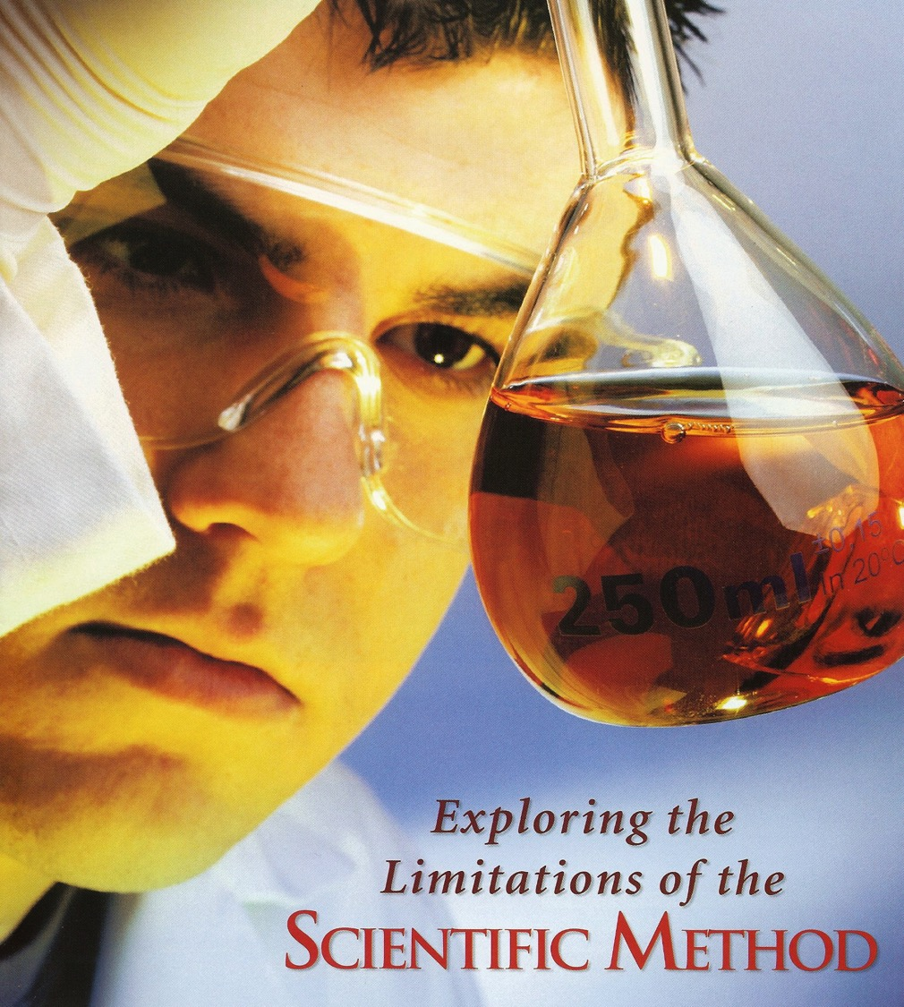
What is it?
What can it do?
What can it
NOT do?

Slide 32
Objective Science
Each investigator uses his/her powers of reasoning and observation, sometimes aided by varied equipment and specialised instruments, to learn new things, or to confirm things that others have discovered.
One person’s observations may even be critically re-evaluated by another person whose starting-point assumptions are different and who, therefore, may reach different conclusions.
Such research happens in present time for each investigator.

Slide 33
Science cannot repeat past events, even if those past events are truly historical. Sometimes, however, similar events can be studied in the present by an investigator living in the present.
Science can apply only partially to future events. E.g. weather predictions. E.g. the popular form of stories called science fiction, which is mostly fiction.
At some stages of history, science has been regarded by many as if it were a religion. However, science is not to be given the honour due to God, although scientific procedures are very useful in investigating and getting to know the cosmos that God created.

Slide 34
Note that it is repeatable experiments, science in the present – sometimes called “operational science” – that has resulted in technological innovation.
“Historical science” is an oxymoron, a contradiction in terms. Quite apart from any history of science, “historical science” attempts to set out beliefs about the past that many scientists accept with only superficial evidence.

Slide 35
The “Great Debate”
continues because there are very strongly committed protagonists on both sides.
Some will never believe in a Creator; some will never give up their belief in the Creator…

Slide 36
Yet, a fair and impartial review of a very large quantity of research results points to there being an Intelligent Designer Who, in the Bible, is revealed as God the Creator, the One Who initiated the cosmos and human history...

Slide 37
Black

Slide 38
Creation link at BibleStudyDownloads.org
Get this presentation for free!
Notes:
Creation (cr)

